Slide 1
Sherwood v. Walker
Wood v. Boyton
Richard Warner
​

Slide 2
Sherwood and Wood
Sherwood v. Walker and Wood v. Boynton usually used to show how fuzzy the notion of a "basic assumption" is.
In Sherwood the court says that a barren cow is fundamentally different kind of animal than a fertile cow, so the mistake about fertility involved a basic assumption on which the contract was made.
In Wood the courts says that a diamond is not fundamentally different a piece of topaz, so the mistake in thinking that the diamond was topaz does not involve a basic assumption on which the contract was made.
The difference between a diamond and a piece of topaz looks pretty basic--surely as basic as the difference between a barren cow and a fertile cow. So what is going on here?
The issue turns on who should bear the risk here.

Slide 3
Wood v. Boynton
Wood sold a small stone to Boynton, a jeweler.
  “About the 28th of December, I needed money pretty badly, and thought every dollar would help, and I took it back to Mr. Boynton and told him I had brought back the topaz and he says "Well, yes; what did I offer you for it?," and I says, "One dollar"; and he stepped to the change drawer and gave me the dollar, and I went out.”
Neither knew what type of stone it was.
  Boynton thought it might be topaz, a semi-precious stone.
The stone was a diamond in the rough.

Slide 4
A Mistake About A Basic Assumption?
The parties assumed that the stone was not worth much.
This was a basic assumption of the contract.
(a) Yes
(b) No

Slide 5
Information
Who is in the best position to find out what type of stone it is?
  In answering, remember that the jeweler really does not know that type of Stone it is.
(a) Wood
(b) Boynton
(c) Neither

Slide 6
Argument that Wood is in a Better Position to Avoid the Loss
Wood could have investigated further.
She chose not too.
The courts describe this as acting with “conscious ignorance.”
Compare Boynton. He could have investigated—with Wood’s permission, and the expense of the investigation would be wasted if Wood decided not to sell.

Slide 7
Who Ought To Get The Stone?
(a) Wood (the seller)
(b) Boynton (the buyer)

Slide 8
Wood Not Excused
The jeweler keeps the stone.
The court does not engage in the risk of loss analysis.
Instead, it says that topaz and diamonds are pretty much the same kind of stone(!!).

Slide 9
Sherwood v. Walker
Walker sold a cow to Sherwood.
Both parties assumed that the cow, Rose of Aberlone, was infertile.
  An infertile cow is worth less money than a fertile cow (since the fertile cow produces more cows).
Rose was not only fertile. She was pregnant.
The mistaken assumption is that Rose is infertile

Slide 10
Information
Who is in a better position to find know whether Rose is fertile?
(a) Sherwood (buyer)
(b) Walker (seller)
(c) Neither

Slide 11
Argument that Walker is in a Better Position to Avoid the Loss
Walker could have investigated further and knew the history of Rose.
Compare Sherwood. He could have investigated—with Walker’s permission, and the expense of the investigation would be wasted if Walker decided not to sell, or Wood decided not to buy.

Slide 12
Walker Keeps the Cow
Why?
One explanation: the case is wrongly decided.

Slide 13
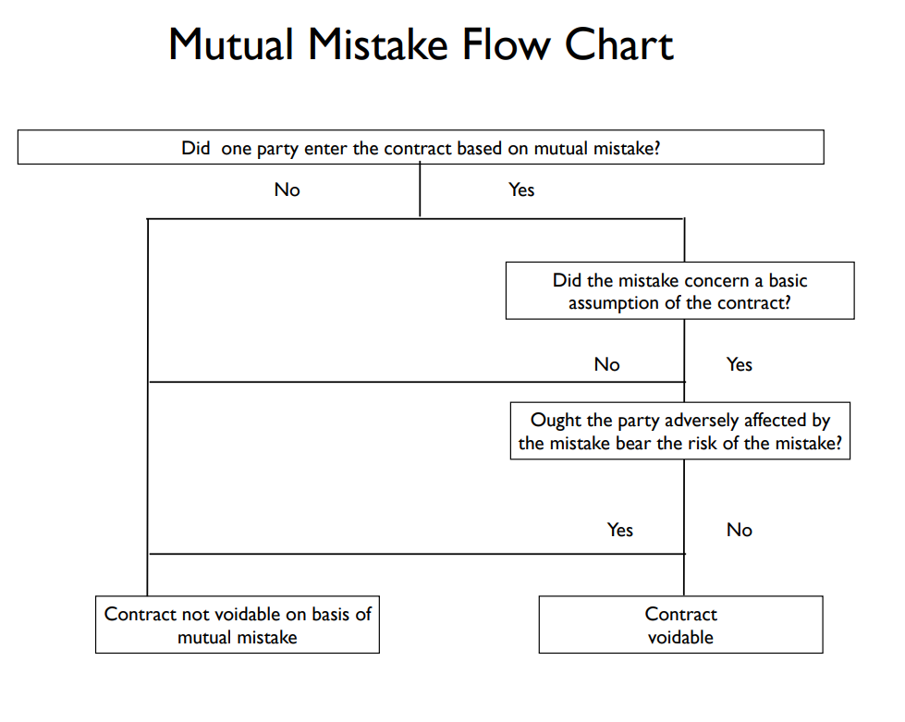

Slide 14
Threshold condition unfulfilled?
No
Yes
No excuse
Contract assigns risk of loss to defendant explicitly or implicitly?
No
Yes
No excuse
Reasonable custom assigns loss?
Yes
No excuse
No
Normative and economic considerations assign loss to defendant?
Yes
No
No excuse
Defendant excused

Slide 15
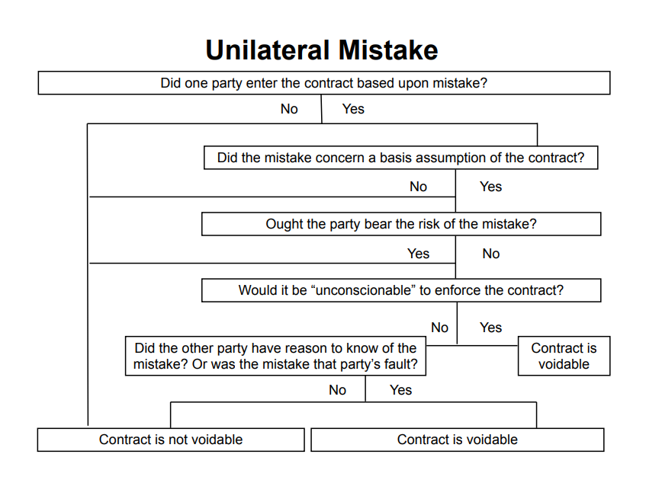

Slide 16
Elinsore Union v. Kastorff
What was the mistake here? The contractor added up his figures wrong; he submitted a bid just under $90,000 when he meant to bid just under $99,500.
The contractor discovered his mistake the next morning and tried to cancel, but the school dist. insisted that it was too late, that the contract has already been made.
The court held that the contractor could rescind the contract.

Slide 17
Two Questions
Break the issue down into two questions:
(1) Who should bear responsibility for the mistake?
(2) How much of the loss should be allocated to the person that bears that responsibility?

Slide 18
Variation on Elsinore
Change the facts of Elsinore a bit.
Suppose the school district had no way of discovering the mistake, and the contractor did not notice it either. The contractor begins work, spends $10,000, and then notices the mistake.
Can the contractor get out of the contract? Not likely.
When the mistake has caused losses, and the district had no way of noticing the mistake, the loss will fall on the contractor = the person in the best position to correct the mistake.

Slide 19
Another Variation
The school district still has no way of realizing the mistake, but this time the contractor discovers the mistake prior to beginning work.
The school district can still accept the next lowest bid--say that was $97,000. This is not as good as the $90,000 contract, but they are no worse off than if the mistake had not been made.
Then the $97,000 bid would have been the lowest.
Likely to excuse in this case.

Slide 20
A Third Variation
The district has to put out a new round of bids.
This costs them $500 in administrative costs, and the new lowest bid is $98,000, not $97,000.
Then the mistake has caused $1500 in damage.
Should the bidder be liable for this much? Many case reach such a result.
  Best approach here is equitable apportionment.

